Slide 1
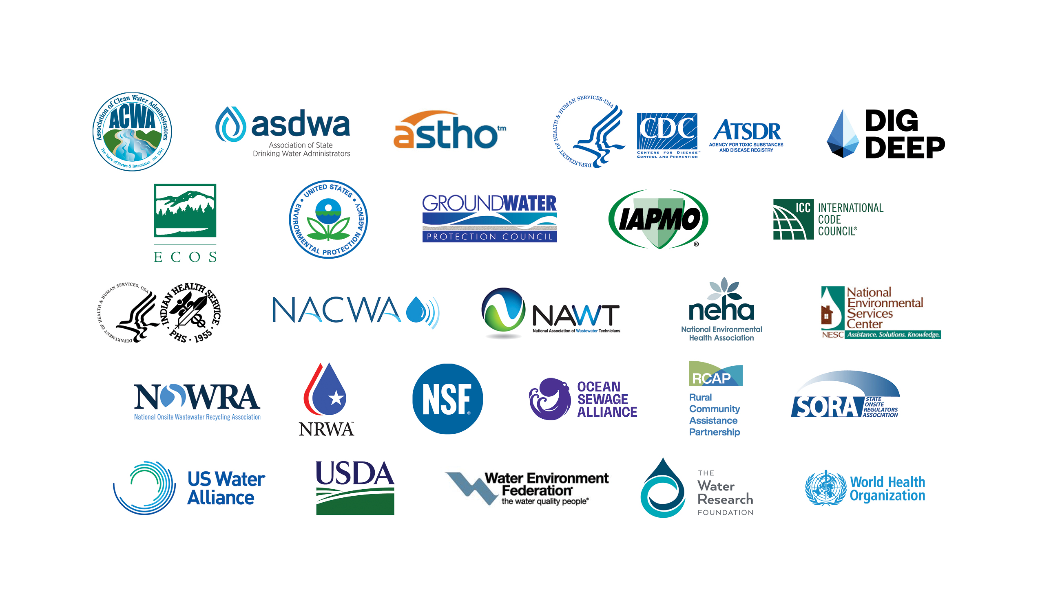

Slide 2
Mapping Analysis of Septic Systems in Tribal Areas Determining the Prevalence and Potential Condition of Septic Systems Across Reportable American Indian and Alaska Native (AI/AN) Homes Preliminary Results
December 6, 2023
DRAFT - Do Not Cite, Work in Progress

Slide 3
Topics
Analysis Purpose
Who is Affected
Analysis Goals
Data sources
Select map results ideas
Desired outcomes

Slide 4
Purpose: Why Doing This?
Congressional funding about $30M/year for wastewater infrastructure for Tribal communities:
WWTPs, Lagoons, Collection Piping, Lift Stations and Septics
Most common project? Septics / decentralized / onsite / scattered systems
Strong and robust partnership between EPA and Indian Health Service (IHS)
EPA & IHS partnering to evaluate available data to determine:
(1) location of septics systems
(2) condition of septic systems
Proxy for condition : higher risks of potential septic system failure by using socioeconomic data that can indicate a knowledge or financial barrier

Slide 5
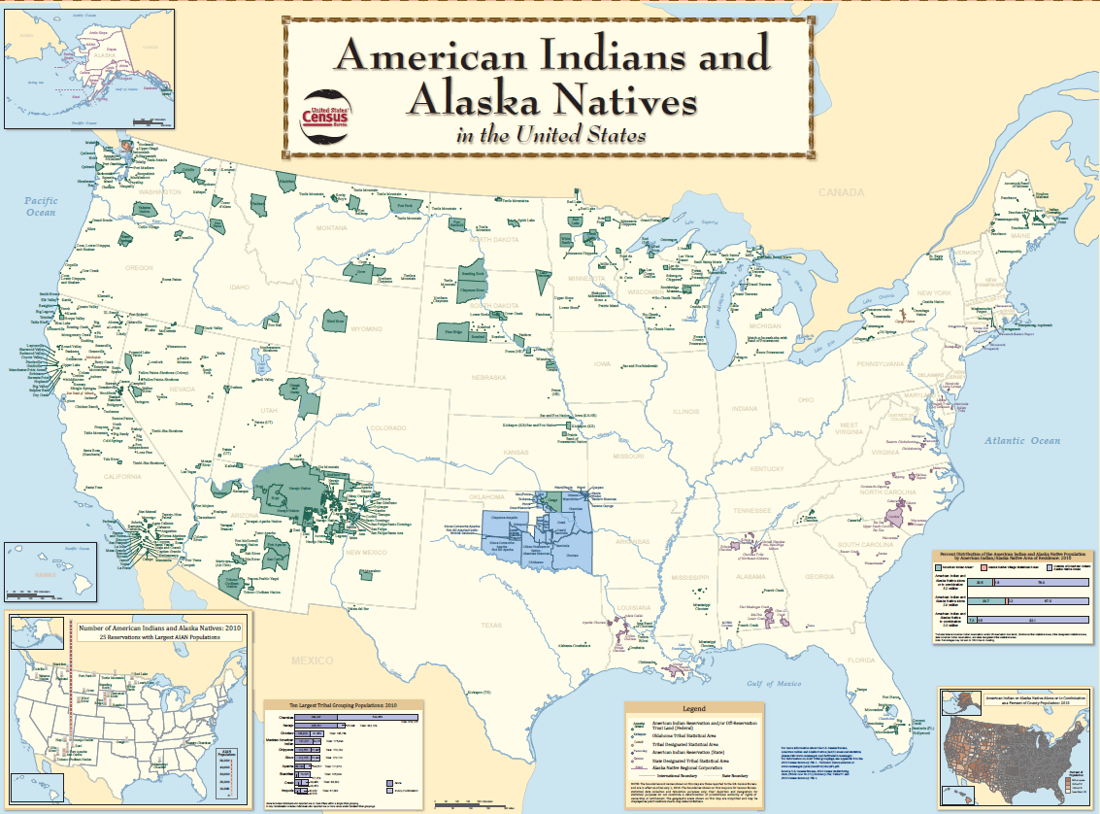
Universe includes the 574 Federally recognized Tribes and Alaskan Native Villages

Slide 6
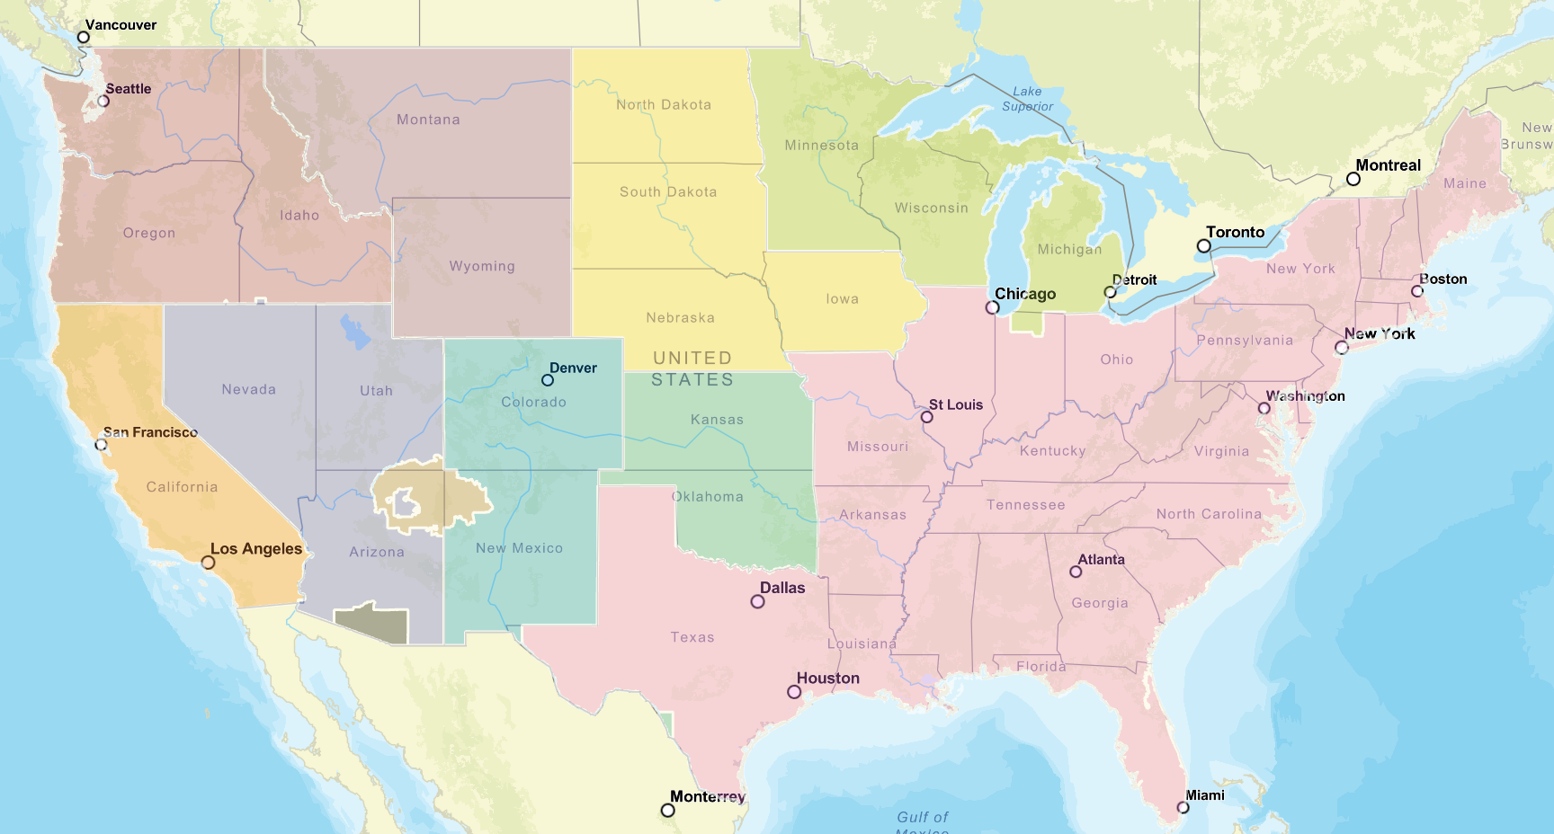
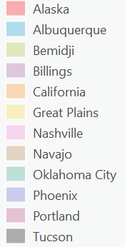
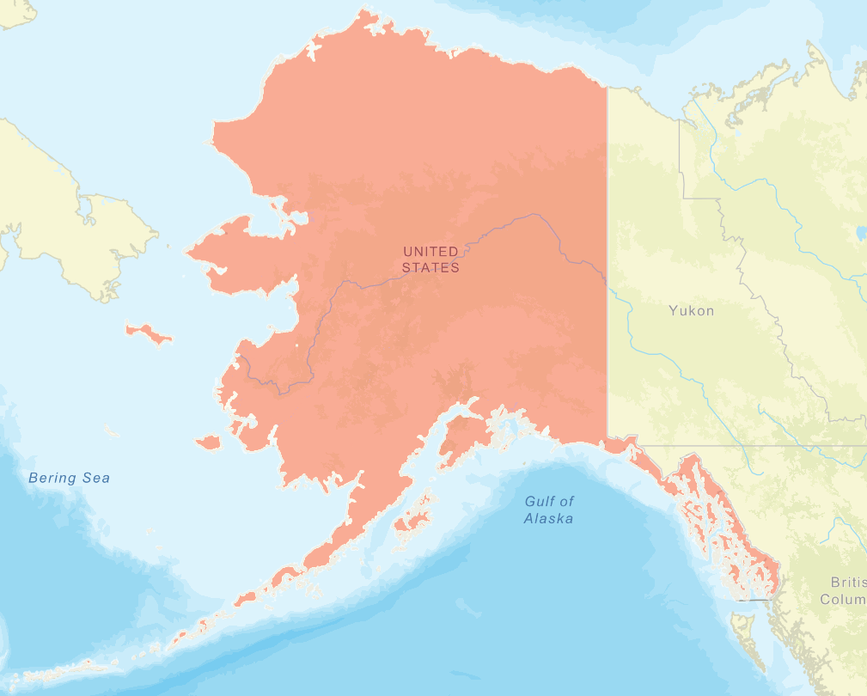
Project Overview – Goals
Determine prevalence of septic systems in AI/AN Communities;
Determine potential condition of septic systems in AI/AN Communities using socioeconomic factors as proxies of financial or knowledge barriers
Map of 12 Indian Health Service (IHS) Areas

Slide 7
Data Sources
IHS’ Sanitation Tracking and Deficiency Reporting System (STARS):
Community Deficiency Profile: Provides the “Universe” of Communities in an IHS Area
Operations and Maintenance Data System (OMDS) : Identifies Communities served by a sewer system
Home Inventory Tracking System (HITS): Provides an inventory of all Reportable homes. Includes optional data fields that identify a wastewater system type.
Utility sewer mains and laterals data (in Navajo and Tucson Areas)
US Census - 2020 American Community Survey (ACS), 5-year survey

Slide 8
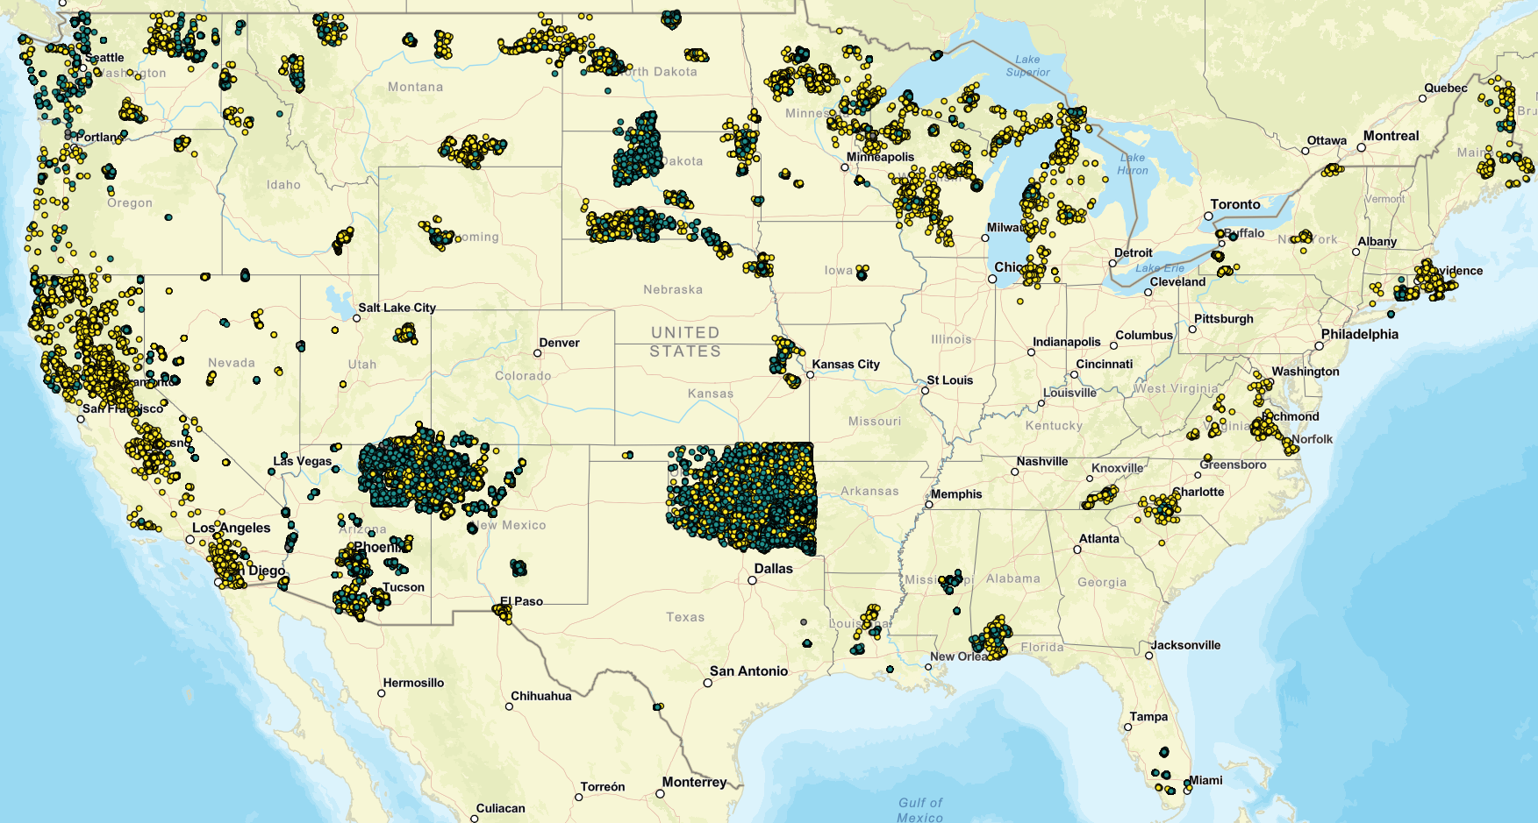
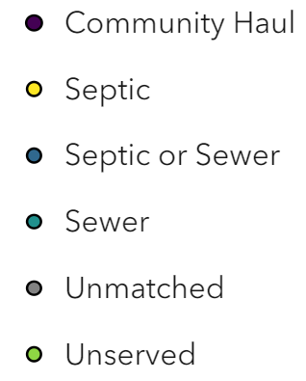
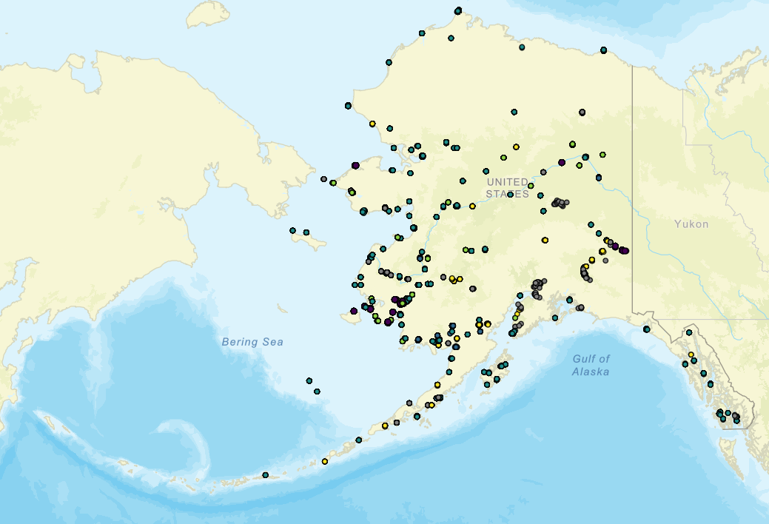
Reportable IHS Homes by System Type

Slide 9
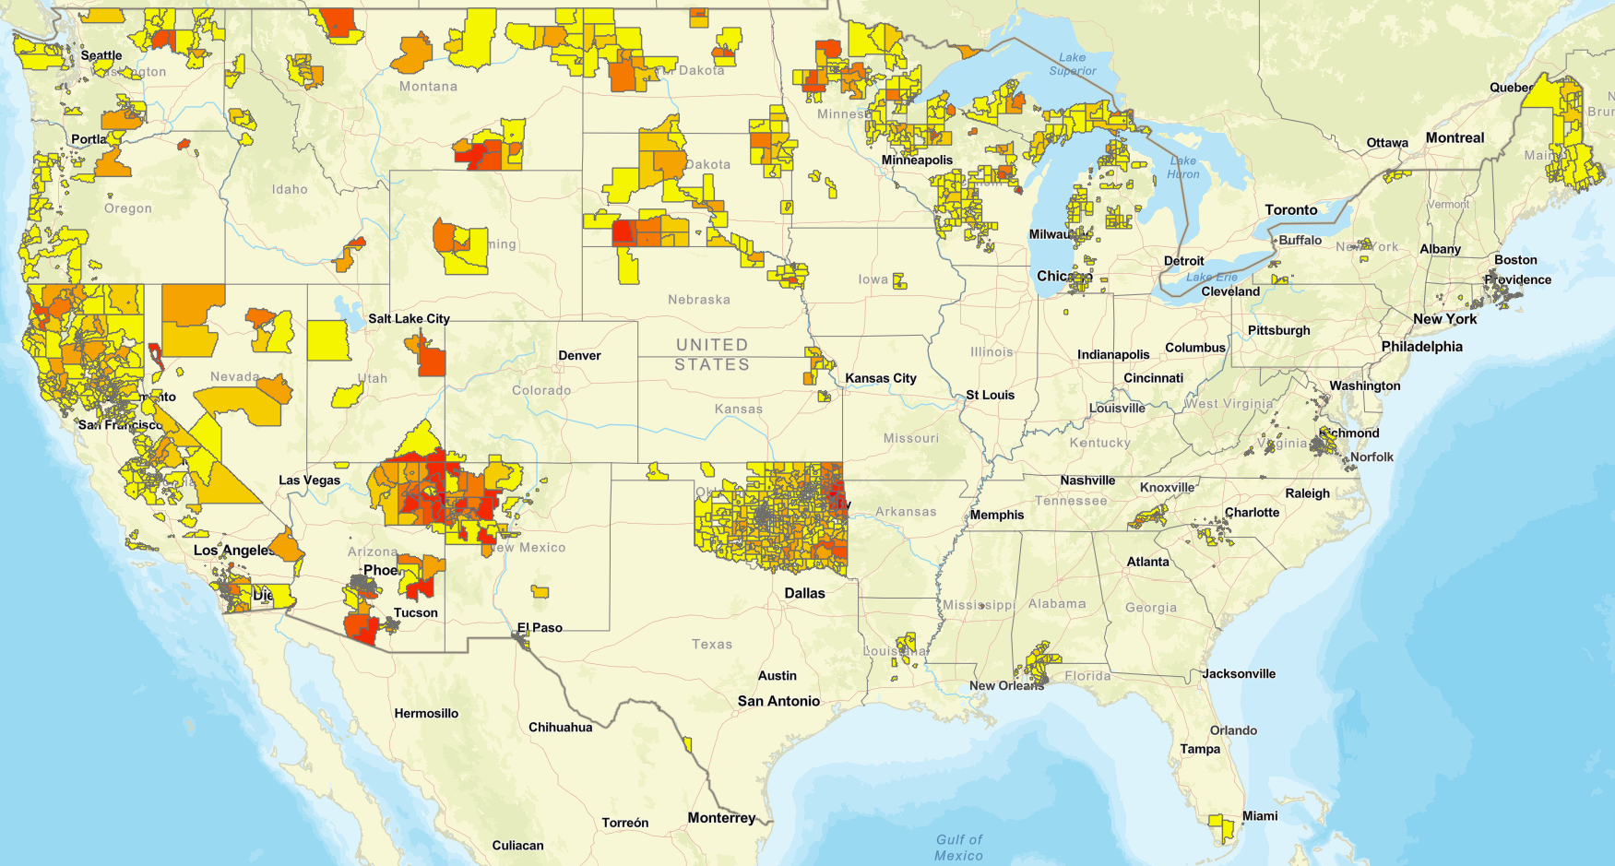
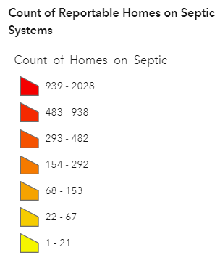
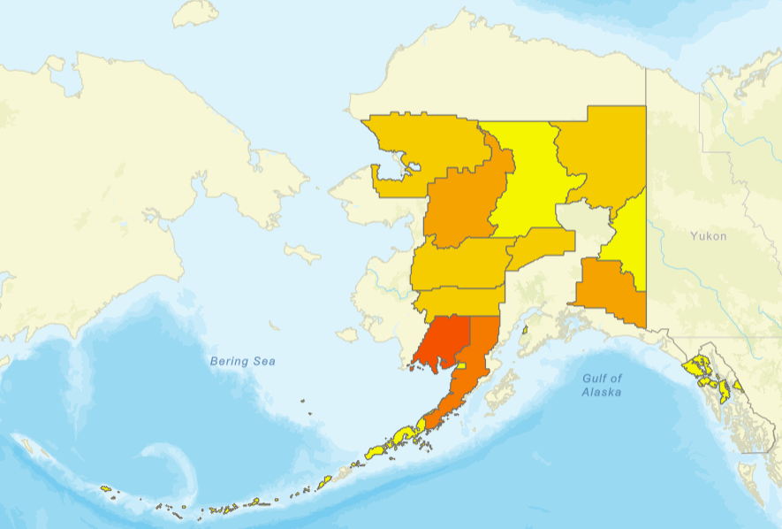
Count of Reportable Homes on Septic, Census Tract

Slide 10
Socioeconomic Proxies
Literature reviewed to identify socioeconomic factors that are cited as being associated with higher rates of septic system failure.
Data from 2020 American Community Survey (ACS), 5-year survey, (Census Tract)
Information Barriers: Factors that may influence someone’s knowledge or access to knowledge about proper septic system operations, maintenance, or repair activities
Educational Attainment
Linguistic Isolation
Race
Financial Barriers: Factors that may influence someone’s ability to afford maintenance or repair activities
Poverty
Unemployment
Notes:
A literature review helped identify socioeconomic factors that are cited as being associated with higher rates of septic system failure.
Limitations:
Research Availability: Limited research available on socioeconomic factors that are associated with or can contribute to higher rates of septic system failure.
Data Representation: Available research tends to include case studies on non-Tribal communities in the South and Northeast regions of the U.S. Data for factors identified come from the census surveys. In the 2020 Census, American Indian and Alaska Native population was undercounted by an estimated 4.9% (Dillingham, 2020).
Nuances to Consider:
Presence of Area outreach programs can reduce information barriers
Reduced access to services regardless of socioeconomic factors:
Limited workforce (not enough technicians for repair/maintenance activities)
Limited equipment (e.g., pump trucks or disposal facilities)
Geographic barriers: Challenges in getting septic system technicians/pump trucks to remote areas (limited economies of scale)
Environmental factors (e.g., soil types etc.)

Slide 11
Example Study Outcome – Alaska
Type of Wastewater System | Count | Percentage
Septic | 601 | 3 %
Sewer | 11,695 | 64 %
Community Haul | 1,791 | 10 %
Unserved | 1,295 | 7 %
Unmatched | 2,780 | 15 %
Notes:
This map shows the census tracts in Alaska where the counts of IHS homes have been aggregated. Darker blue indicates a higher percent of reportable homes with septic systems (illustrating the density of septic systems over total homes). The table describes the types of wastewater systems accounted for in the Alaska IHS Area. Note that Alaska is the only IHS Area with additional categories of “Community Haul” and “Unserved”

Slide 12
Example Study Outcome – Alaska
Knowledge Barriers
Financial Barriers
Notes:
This graph shows the percentage of homes on septic at the 80th percentiles for each identified at-risk factor. For example, 23% of Septic Homes in Alaska IHS are in census tracts at 80th National Percentile for Less than High School Education.
Socioeconomic Factor Definitions
Percent people of color: The percent of individuals in a census tract who list their racial status as a race other than white alone and/or list their ethnicity as Hispanic or Latino. That is, all people other than non-Hispanic white-alone individuals. The word "alone" in this case indicates that the person is of a single race, not multiracial.
Percent low-income: Percent of individuals whose ratio of household income to poverty level in the past 12 months was less than 2 (as a fraction of individuals for whom ratio was determined).
Unemployment: All those who did not have a job at all during the reporting period, made at least one specific active effort to find a job during the prior 4 weeks, and were available for work (unless temporarily ill).
Percent in limited English speaking: Percent of households in which no one age 14 and over speaks English "very well" or speaks English only (as a fraction of households).
Percent less than high school education: Percent of individuals age 25 and over with less than high school degree.

Slide 13
Example Study Outcomes – Bemidji IHS Area
Type of Wastewater System | Count | Percentage
Septic | 9,932 | 52 %
Sewer | 9,001 | 47 %
Unmatched | 148 | 1 %
Notes:
This map shows the census tracts in the Bemidji IHS area where the counts of IHS homes have been aggregated. Darker blue indicates a higher percent of reportable homes with septic systems (illustrating the density of septic systems over total homes). The table describes the types of wastewater systems accounted for in the Bemidji HIS, which spans three full states and partially another (Minnesota, Wisconsin and Michigan, and part of Indiana. Note that Bemidji has a roughly even split between Septic and Sewer wastewater types.

Slide 14
Example Study Outcomes – Bemidji IHS Area
Knowledge Barriers
Financial Barriers
Notes:
This graph shows the percentage of homes on septic at the 80th percentiles for each identified at-risk factor. Bemidji has low percentages of septic homes that meet the 80th percentiles for at-risk factors.
Socioeconomic Factor Definitions
Percent people of color: The percent of individuals in a census tract who list their racial status as a race other than white alone and/or list their ethnicity as Hispanic or Latino. That is, all people other than non-Hispanic white-alone individuals. The word "alone" in this case indicates that the person is of a single race, not multiracial.
Percent low-income: Percent of individuals whose ratio of household income to poverty level in the past 12 months was less than 2 (as a fraction of individuals for whom ratio was determined).
Unemployment: All those who did not have a job at all during the reporting period, made at least one specific active effort to find a job during the prior 4 weeks, and were available for work (unless temporarily ill).
Percent in limited English speaking: Percent of households in which no one age 14 and over speaks English "very well" or speaks English only (as a fraction of households).
Percent less than high school education: Percent of individuals age 25 and over with less than high school degree.

Slide 15
Proposed Outcomes & Deliverables
Outcomes
Encourage additional outreach, technical assistance, funding, programmatic activities
Foundation for additional research
Foundation for combining environmental or other datasets
Empower AI/AN Communities, community-based organizations, and other stakeholders
Deliverables
Research summary flyer
Research report to be published on EPA website
Public web map / GIS layers that allow interactive engagement and public data analysis
Notes:
Encourage additional outreach, technical assistance, funding, and programmatic activities focused on supporting AI/AN Communities utilizing septic systems, especially those with a high potential of failure based on socio-economic conditions where septic systems are located;
Establish a foundation for additional research to further refine the prevalence of septic systems in AI/AN Communities;
Establish a foundation for combining environmental or other datasets with septic system usage datasets to estimate potential for current or future septic system failure;
Empower AI/AN Communities, community-based organizations, and other stakeholders to advocate for increased programmatic support for septic systems by publishing data on the prevalence of septic systems in AI/AN Communities.

Slide 16
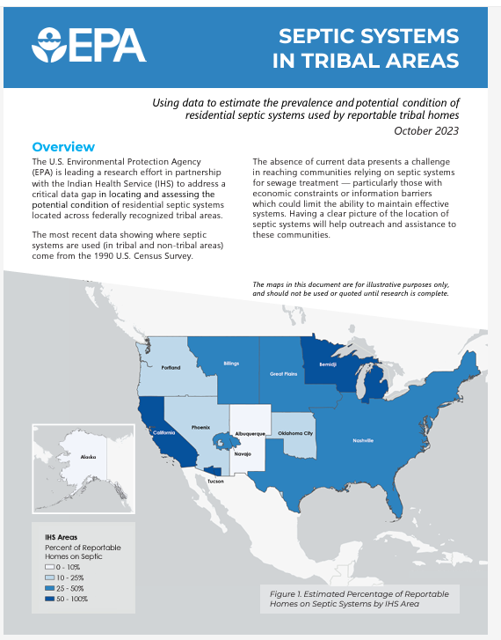
More info at:
https://www.epa.gov/small-and-rural-wastewater-systems

Slide 17
Thank you
Matthew Richardson
US EPA
Office of Water
Richardson.Matthew@EPA.gov

Slide 19
Enhanced onsite wastewater treatment to reduce groundwater pollution lessons from a demonstration study in Cape Cod, Massachusetts
Laura Erban, PhD
Office of Research and Development
Center for Environmental Measurement and Modeling, Atlantic Coastal Environmental Sciences Division
EPA Decentralized Wastewater
MOU Partnership Renewal
December 6, 2023

Slide 20
Acknowledgments
Local farmers and other landowners
Disclaimer: The views expressed in this presentation are those of the author(s) and do not necessarily represent the views or policies of the U.S. Environmental Protection Agency. Any mention of trade names, products, or services does not imply an endorsement by the U.S. Government or the U.S. Environmental Protection Agency. The EPA does not endorse any commercial products, services, or enterprises.

Slide 21
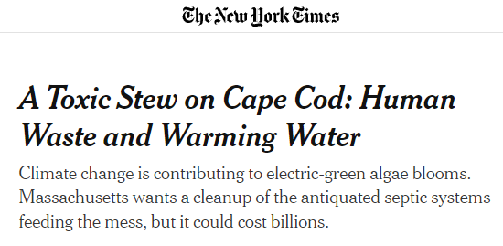
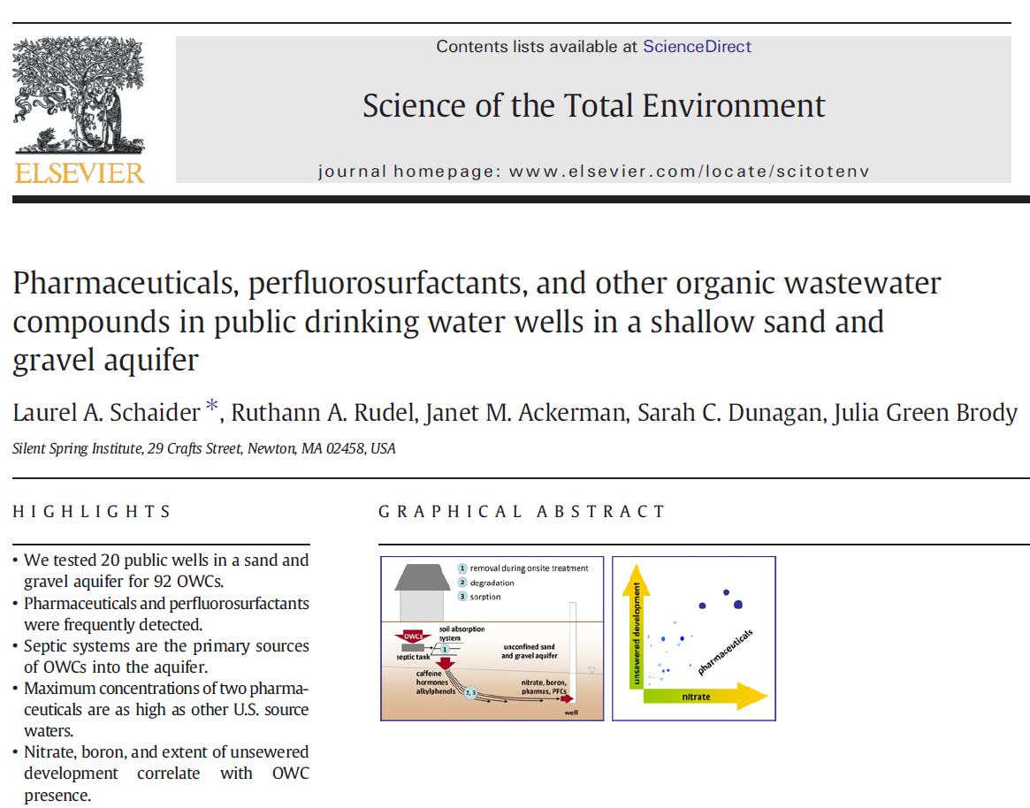
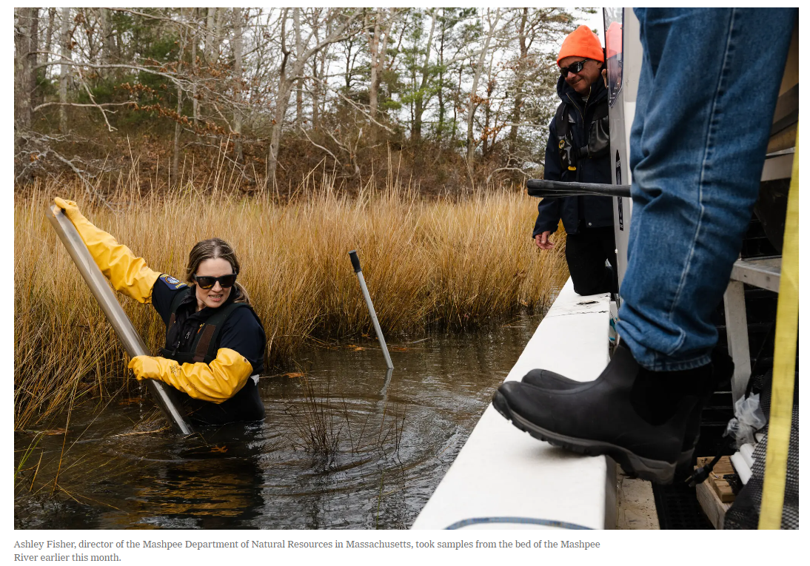
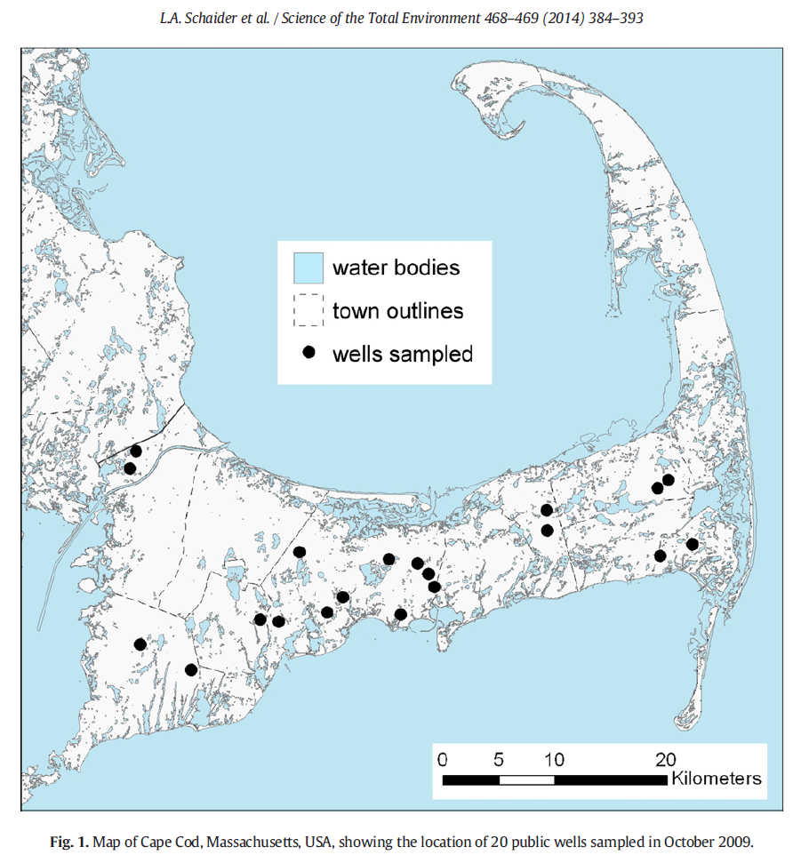
Nutrients and co-pollutants in onsite wastewater can overload water resources
More than 30 Cape Cod watersheds have TMDLs for nitrogen. Source: Twichell et al., 2019. EPA/600/R-19/107

Slide 22
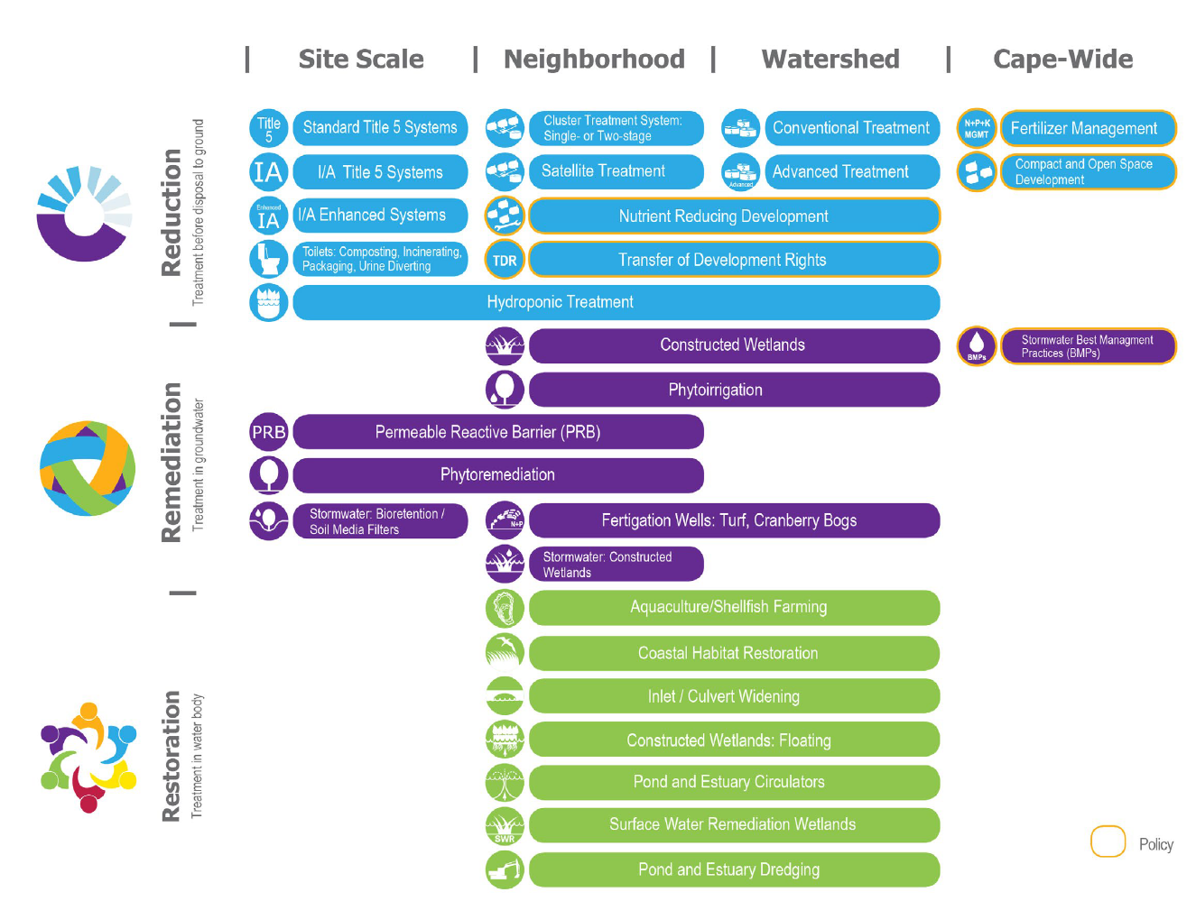
Cape Cod communities are pursuing multiple means of load reduction
Clean Water Act (CWA) Sections
208: Areawide Waste Treatment Management
303: Water Quality Standards & Implementation Plans
303(d) → Total Maximum Daily Load (TMDL)
TMDLs call for >50% reduction in nitrogen (N) loading
from septic systems Cape-wide and up to 100% in some
sub-watersheds.
Water Quality Technologies Matrix; Cape Cod Area Wide Water Quality Management (“208”) Plan Update (2015)

Slide 23
Cape Cod communities are pursuing multiple means of load reduction
Innovative/Alternative (I/A) septic systems have historically sought to meet a 19 mg/L total nitrogen (TN) effluent performance goal.
New Massachusetts regulations (2023) specify 10 mg/L TN as goal for best available nitrogen reducing technology.
50 installations and 3 years of monitoring are required for general use approval.
Water Quality Technologies Matrix; Cape Cod Area Wide Water Quality Management (“208”) Plan Update (2015)

Slide 24
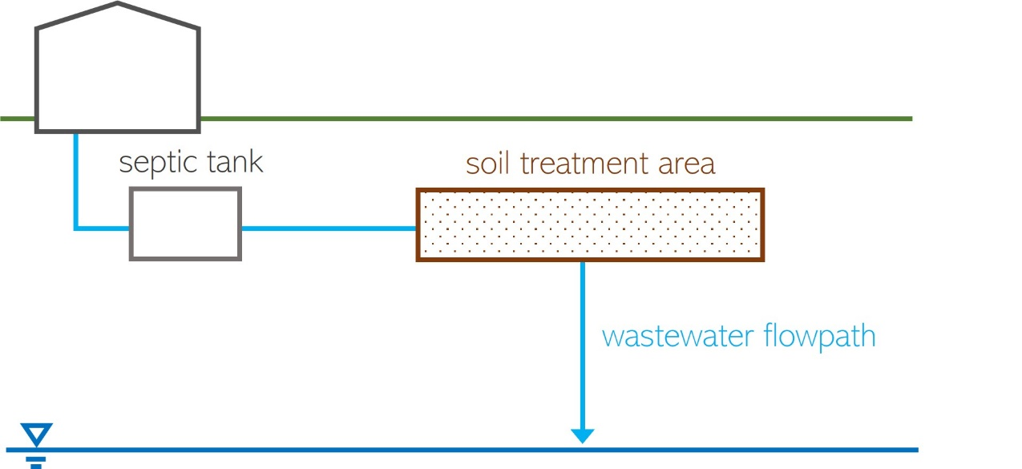
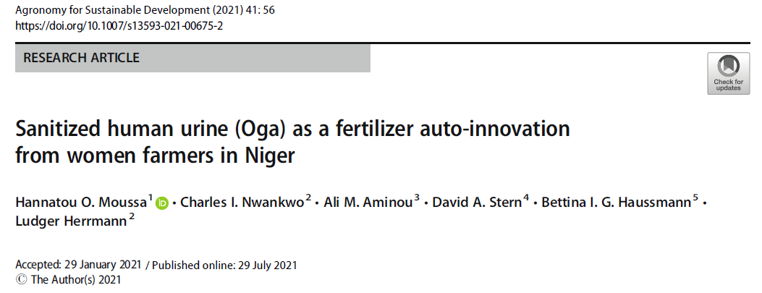
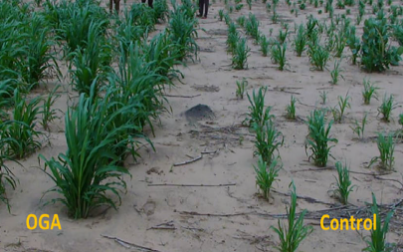
Enhancing onsite wastewater treatment
conventional septic system
alternatives
separate waste streams (urine diversion, composting toilets, tight tanks)
add treatment stage(s) for mixed effluent
* Note that the diagram is simplified and not to scale!

Slide 25
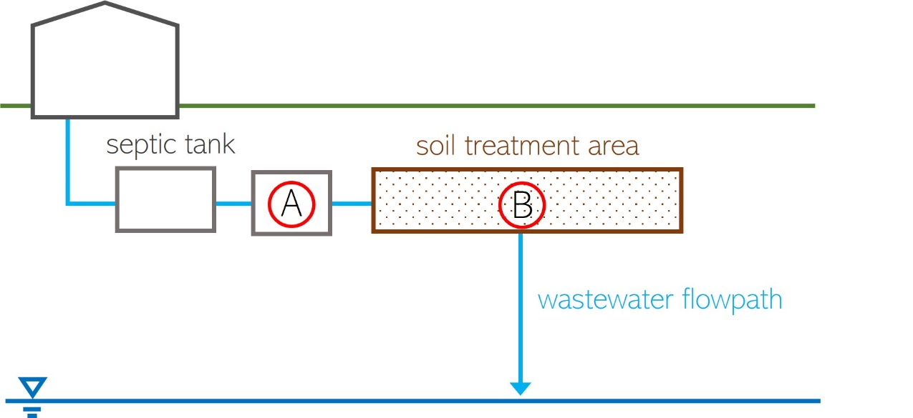
Enhancing onsite wastewater treatment of nitrogen
alternative septic system
N₂ gas
Septic systems designed for nitrogen removal:
A) add a treatment unit after the septic tank and
before soil treatment area (a.k.a. leach field)
OR
B) modify the soil treatment area
(in general terms)
* Note that the diagram is simplified and not to scale!

Slide 26
Enhancing onsite wastewater treatment of nitrogen
alternative septic systems
A
Many technologies exist, with variable:
Performance (effluent quality, costs, maintenance, aesthetics)
Approval and availability, by state
Best available approach, by site (lot layout, depth to groundwater, other constraints)
tank
soil treatment area
treatment unit before STA
wastewater flowpath
B
tank
soil treatment area
modify STA
wastewater flowpath
* Note that the diagram is simplified and not to scale!

Slide 27
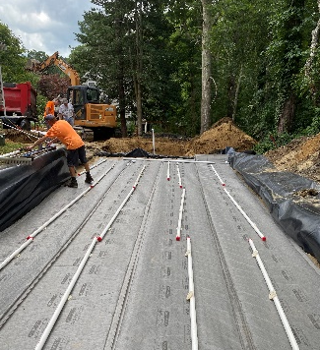
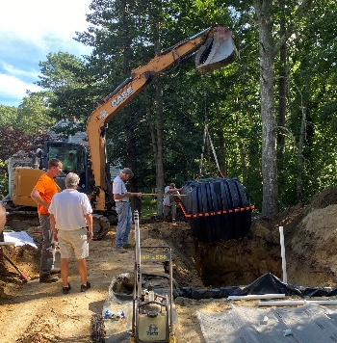
Enhancing onsite wastewater treatment of nitrogen
alternative septic systems
Designs with a lignocellulosic carbon source can provide a high degree of N removal.
Two designs (proprietary and non-proprietary) use woodchips in this demonstration effort.
A
tank
soil treatment area
treatment unit before STA
wastewater flowpath
A
B
B
tank
soil treatment area
modify STA
wastewater flowpath
NiTROE® treatment unit
by KleanTu LLC
modified STA
by MASSTC
* Note that the diagram is simplified and not to scale!

Slide 28
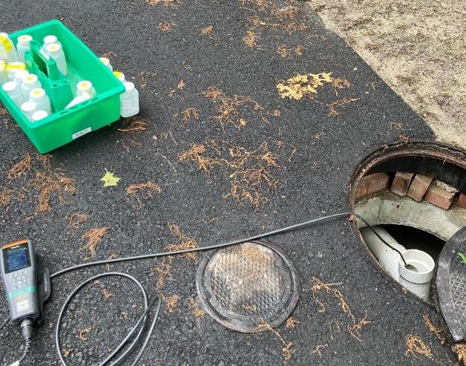
Monitoring wastewater nutrient loads
alternative septic systems
Influent concentrations
Effluent concentrations
Flow to system
,
tank
soil treatment area
1
2
Partners
treatment unit before STA
wastewater flowpath
tank
soil treatment area
1
2
modify STA
wastewater flowpath
homeowners
MASSTC monitors the septic systems
* Note that the diagram is simplified and not to scale!

Slide 29
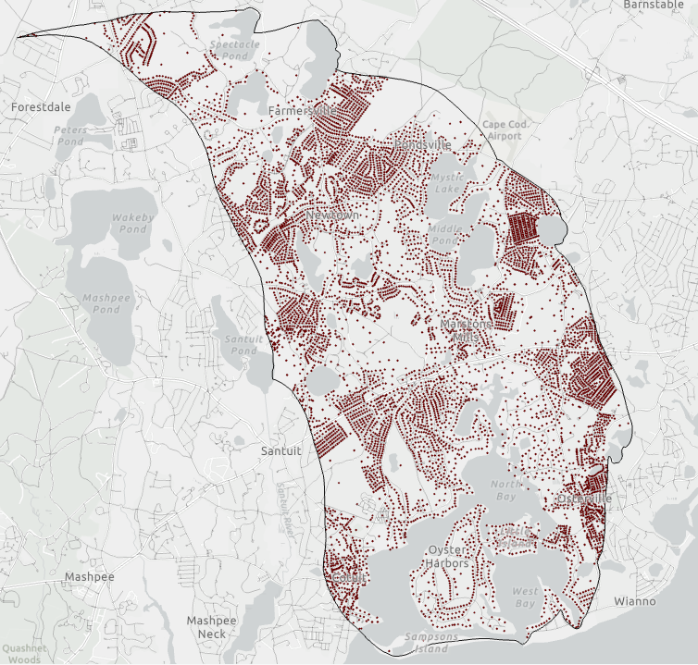
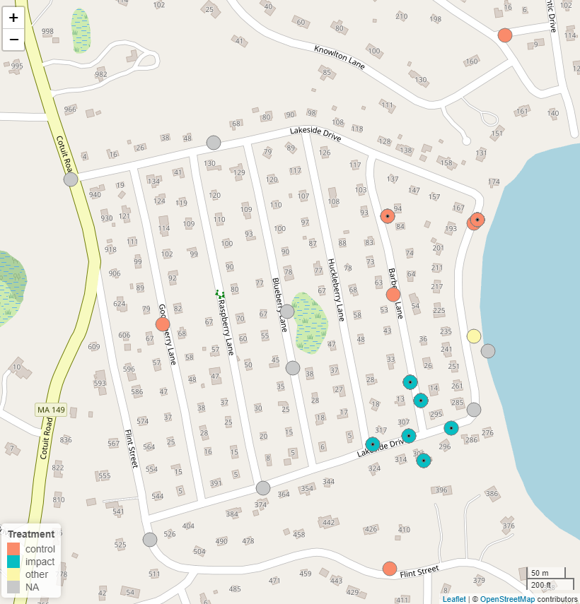
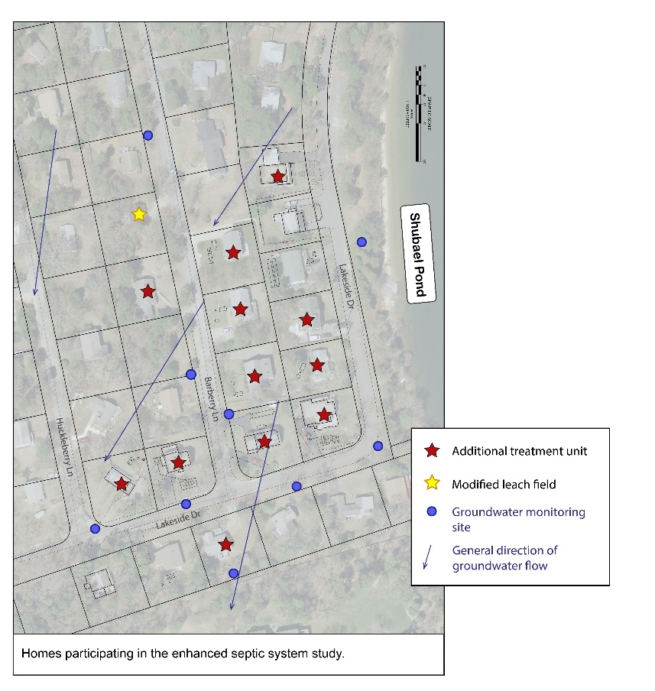
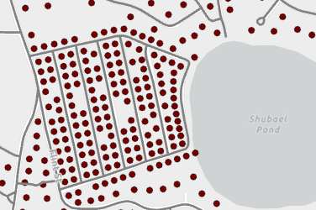
Monitoring impact on groundwater quality
watershed screening
well network
alternative septic systems
Partners
Indicates multiple sampling depths at site
onsite wastewater treatment system
General direction of groundwater flow

Slide 30
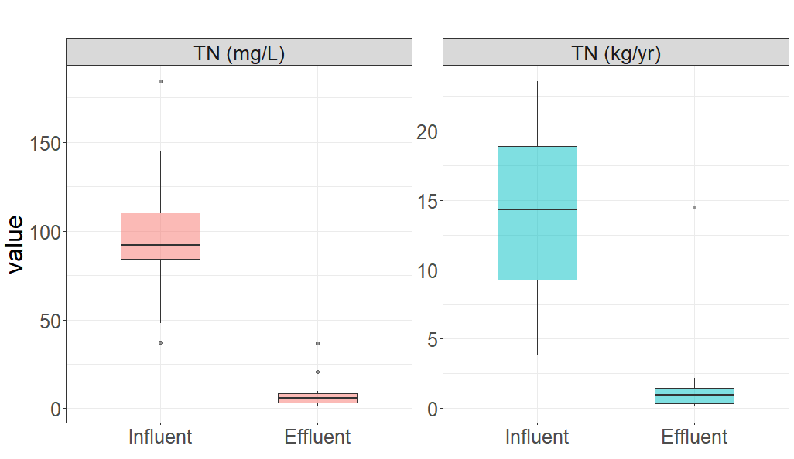
Enhanced septic system demonstration: results in progress
concentration
load
Load estimates shown here are based on mean daily flow, mean monthly influent and effluent concentrations for each system.
Boxes depict spread in
estimates across systems.
Median total nitrogen (TN)
reduction:*
concentration: 94%
load: 93%
* values are sensitive to samples
included and method of estimation
14.3
Partners
92.0
5.7
1.0
as of 2023-05 (6 to 18 months of sample data)
Labels are median values for the group of systems (n=12)
homeowners
Preliminary Information-Subject to Revision. Not for citation.
Notes:
Exclude site E which does not have water use data or load estimates. Includes site M, the nonproprietary system.

Slide 31
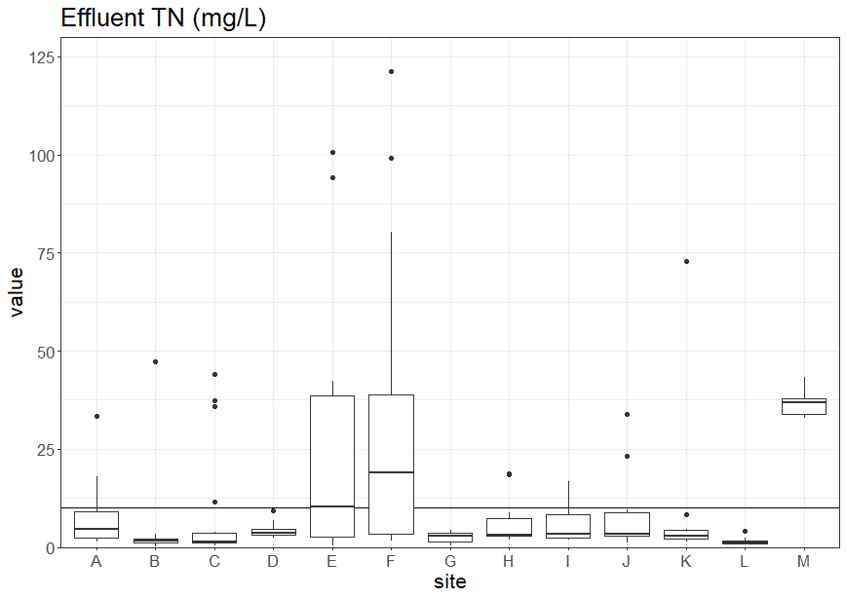
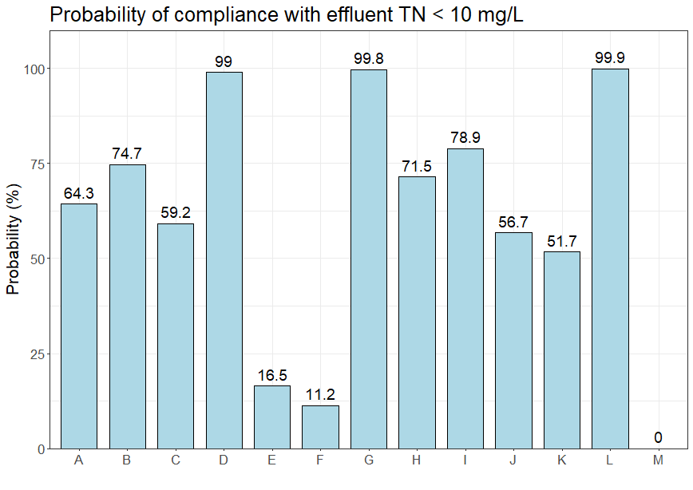
Reliability of individual systems
Varies by household, technology, system adjustments.
High performance requires good design, use, and maintenance.
Monitoring and maintenance costs scale with number of systems.
How might we implement cluster systems and/or responsible management entities?
10
Reliability calculated as in Oakley et al., 2010.
Preliminary Information-Subject to Revision. Not for citation.
Notes:
Site E has no flowmeter, not included in prior figures. Advanced wastewater treatment systems reliant on diverse communities of microorganisms. They may be sensitive on a temporary or long-term basis to inputs like harsh cleaning products or chemotherapies.

Slide 32
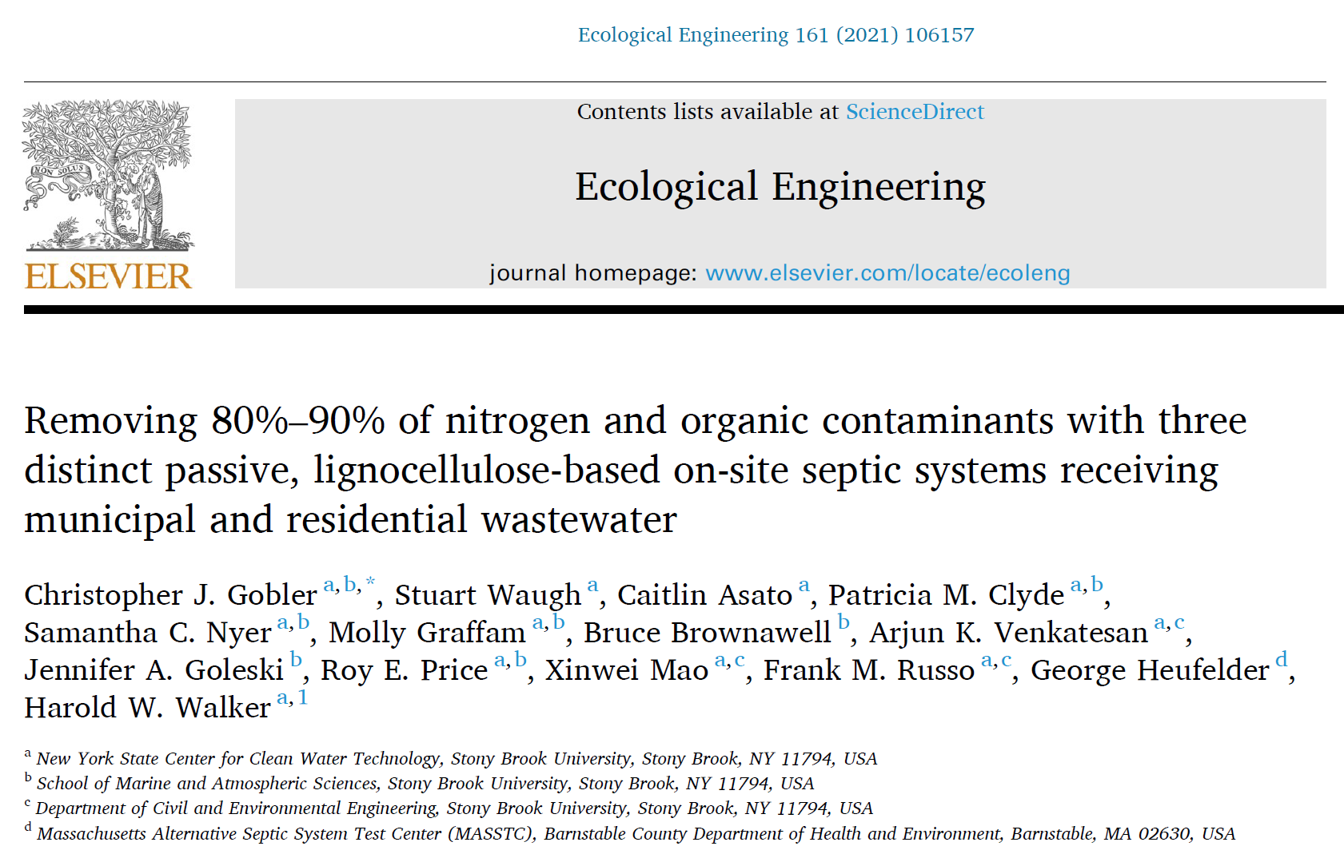
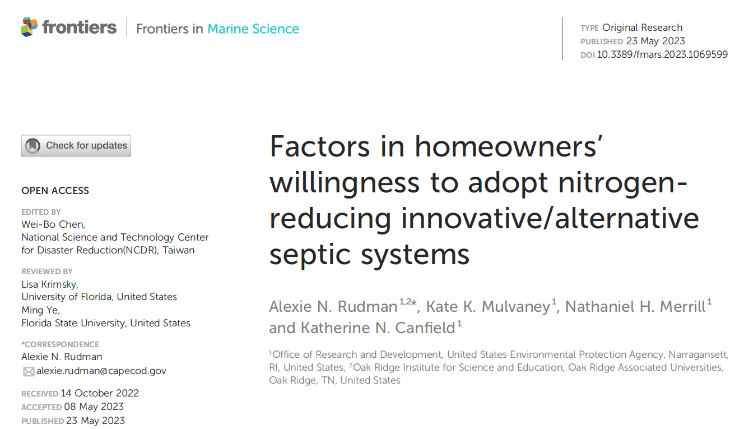
Enhanced septic system performance: beyond nitrogen
Notes:
Contaminants in Gobler et al: n = 11; acetominophen, atenolol (blood pressure), caffeine, cotinine (nicotine metabolite), DEET (insect repellant), diphenhydramine (antihistamine), metaprolol (blood pressure), nicotine, paraxantine (caffeine metabolite), sulfamethoxazole (antibiotic), trimethoprim (antibiotic)
Factors in Rudman et al: mandate, capital cost, O&M&M, installation process, aesthetics (noise, small), access, future options, impact on resale

Slide 33
Enhanced septic systems in context
One of many solutions
Total mass of pollutants
Values and perceptions of people
Limitations and co-benefits
legacy wastewater pollution
Wetland restoration site. Photo: K. Canfield
Source: Cape Cod Area Wide Water Quality Management (“208”) Plan Update (2015)

Slide 34
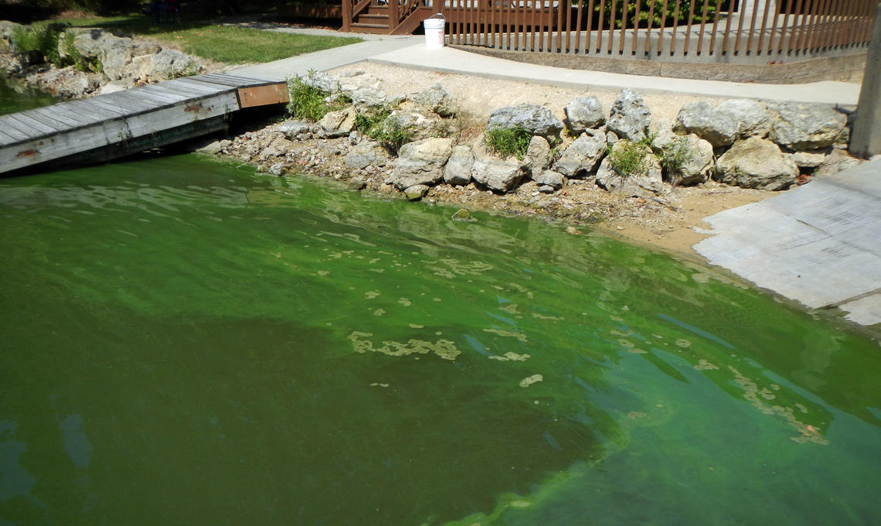
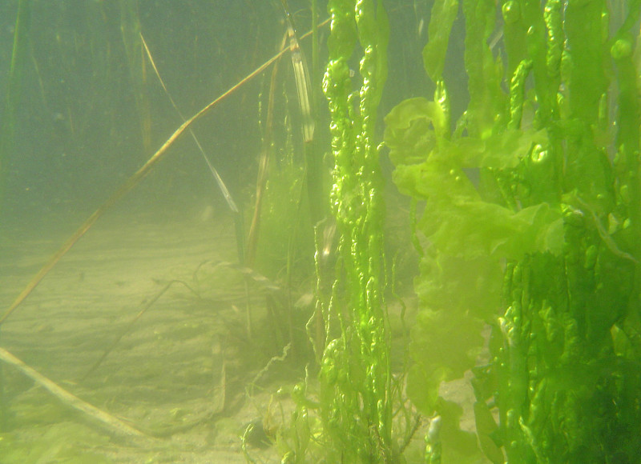
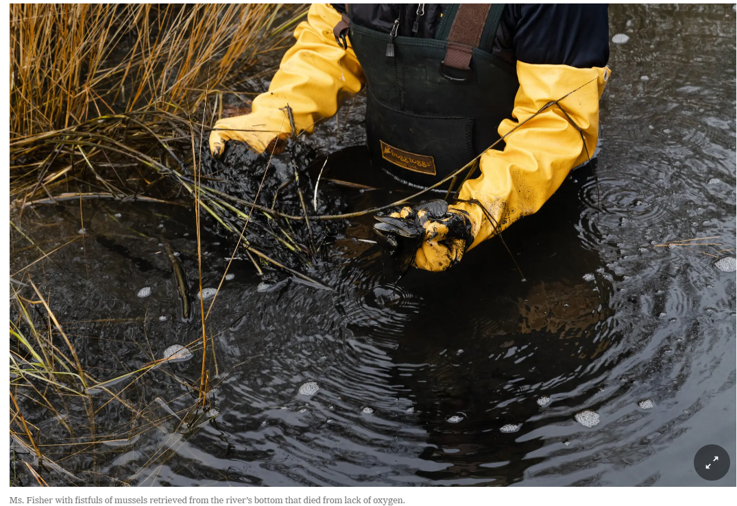
Summary and directions
Reducing onsite wastewater pollutant loads is possible.
Incentives are limited.
Consequences of the status quo are indirect and remote.
Design and (redesign) for resilience.
Center equity: who pays, who benefits?
Buzzards Bay Coalition
Town of Masphee
USGS
NYTimes
“…once groundwater becomes contaminated,
it can be extremely difficult and costly to remedy.”
Notes:
Resilience: the capacity to withstand or to recover quickly from difficulties; toughness.

Slide 35
Questions?
erban.laura@epa.gov
Laura Erban, PhD
Office of Research and Development
Center for Environmental Measurement and Modeling, Atlantic Coastal Environmental Sciences Division

Slide 37
Research Needs Scanning Project Headed by:
Dr. Bryan Brooks and Dr. Sara Heger

Slide 38
Needs for Onsite Wastewater Recycling Research
Unique Partnership with NOWRA
Steering Committee with Diverse Representation
Followed established survey and workshop synthesis methods

Slide 39
Phase 1: Survey - Input from hundreds of business, government, academic, NGO’s
Phase 2: Synthesis workshop at 2021 NOWRA Mega-Conference
Phase 3: Results published

Slide 40
Part 1: Identifying Key Research Questions
Address important gaps in knowledge
Realistically researchable
Facts – no value judgements

Slide 41
Part 1: We asked professionals two questions…
What technical scientific research questions if answered, would really advance the science?
What environmental management research questions if answered, would really advance the practice over the next decade?

Slide 42
Overview of Answers (Research Questions)
How can we improve performance and longevity?
How can we determine our impact on the environment and public health and the impact of the environment?
How can we align with other ongoing efforts?
S.R. Burket
Notes:
Food-energy-water efforts across economic conditions and geographic regions
Resource recovery (e.g., nutrients, septage, water) for beneficial reuse applications
Developing robust treatment approaches for diverse constituents (e.g., PFAS, PPCPs, QACs, FOG), for water reuse applications (e.g., fit for purpose)
Effluent quality and social acceptance of water reuse
Resiliency considering climate change, natural disasters and economic challenges

Slide 43
Part 2: Identifying Problem Statements
What are the challenges (existing or new), that impact industry?
What needs to be done to address those challenges?
Statements had to be concise, specific, and measurable with no answers to address them.

Slide 44
Part 2: We asked professionals two more questions…
Within the next 5-10 years, what decentralized wastewater issues or challenges will require new or modified programs or technologies?
What resources or tools will you need to do your job in the future?

Slide 45
Overview of Problem Statements
Addressing the diverse needs across the country.
Address the vast differences in regulatory requirements.
Address the perception of government and the public
S.R. Burket

Slide 46
Overview of Problem Statements
Obtain the funding that matches our infrastructure and management needs.
Educate the end users.
Success in using of reuse/reclamation technologies
S.R. Burket

Slide 47
Overview of Problem Statements
A means to adapt systems that could be affected by climate changes.
Access to necessary materials in all areas.
Garnering respect and financial support for our industry and technologies as sound solutions – not just for the short-term but for the long-haul.
S.R. Burket

Slide 48
Overview of Problem Statements
Attract and educate a sustainable workforce at all levels.
S.R. Burket

Slide 49
Needs for Onsite Wastewater Recycling Research
Next steps…
Preparing manuscripts for publication
Dissemination of findings key stakeholders, funders

Slide 50
Questions
Dr. Bryan Brook, bryan_brooks@baylor.edu
Dr. Sara Heger, sheger@umn.edu

Slide 51
EPA Decentralized Wastewater MOU Partnership Renewal Meeting
December 5-6, 2023

Slide 52
About WRF (The Water Research Foundation)
Our Purpose
To advance the science of water to improve the quality of life for all communities.

Slide 53
WRF Services
Identify, fund, & manage research for the water sector
Educate decision-makers on the science of water
Research
Connections
Educate
Convene experts & sector representatives to identify and collaborate on priority water research

Slide 55
Selected WRF Efforts on Decentralized / Distributed Systems (1)
WRF 5034
WRF 5040

Slide 56
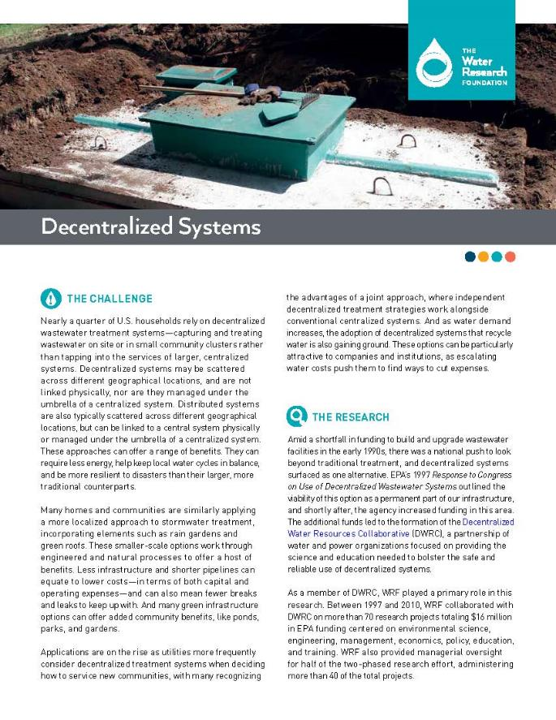
Selected WRF Efforts on Decentralized / Distributed Systems (2)
WRF 4843
WRF 4632

Slide 57
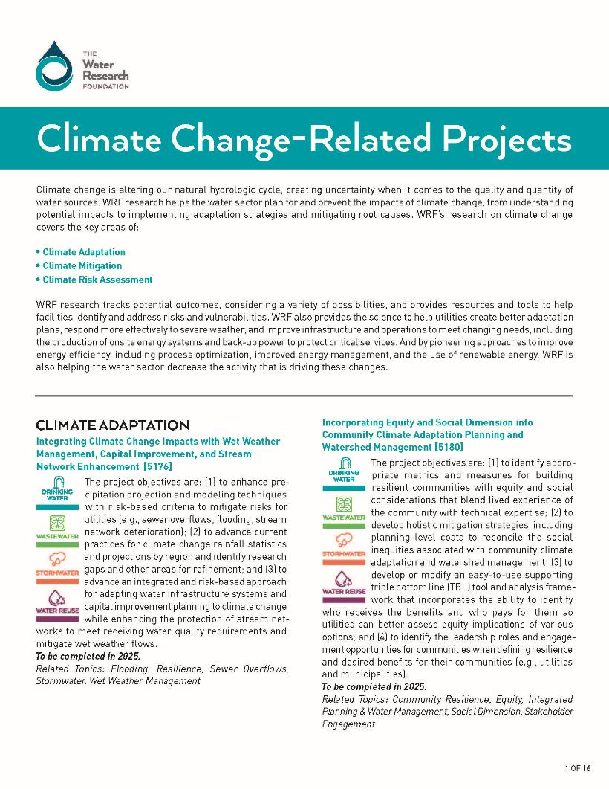
Supporting MOU Workplan Priority 3-1 “Community Resiliency”
WRF’s Climate Change Research:
WRF’s climate change topic hub
WRF’s research portfolios include 70 climate change studies across wastewater, stormwater, drinking water, and reuse water
Climate Risk Assessment
Climate Adaptation
Climate Mitigation (addressing GHGs)

Slide 58
Research
WRF Research Programs
60%
20%
10%
Grant Funded
10%
Subscriber/
Partner
Funded
Unsolicited
Program
10%
Research
Priority Program
Tailored Collaboration Program
Unsolicited
Program
Emerging Opportunities Program
Facilitated Research Program
Emerging Opportunities Program
Paul L. Busch Award

Slide 59
Next Steps by NOWRA (lead) and WRF (co-lead)
MOU Workplan Priority 5-2: Identify decentralized research priorities
Develop prioritized list of research needs
Leverage results of Horizon Scanning Research
Please let us know if you are interested in joining our efforts!
Questions / Suggestions?
WRF Contacts: Harry Zhang (hzhang@waterrf.org); Jeff Moeller (jmoeller@waterrf.org); Miriam Hacker (mhacker@waterrf.org)

Slide 61
Meeting Evaluation Survey

Slide 62
Thank you!

